Slide 1
Case Study TextileX
As Is
As of 2019

Slide 2
Identification
TextileX
Legal form
S.p.a. (joint stock company), family owned
Size
60 people
Turn over 16MEuro
One site

Slide 3
Goal
Utilitarian
Provide products for the best outdoor experience (jackets, pants, shoes, tents, sleeping bags..)
Ateco / nace
Textile manufacturing
Culture
Tradition (est. 1870), family company, community with employees

Slide 4
Structure
CEO
Quality
HR
Advertising, PR
R&D
Sales Italy
Sales abroad
Administration, finance
Production
Internal warehouse and factory
Warehouse finished products
External production
Shop
Customer support
IT

Slide 5
Locally
Design of products, sales and marketing, administration
IT office: 4 people
Outsourced (far east)
Manufacturing of products
Quality control
Outsourced
Warehouse, shippings
Sales: B2B (more recently B2C via ecommerce)

Slide 6
Formalization, specialization
Low level of
Centralization
Decisions taken by CEO and office heads

Slide 7
BMC
Value proposition
Support best outdoor experience through products of high design and quality (performance before fashion)
Provide customization of products, at best ratio quality / price
Customer segments
B2B + B2C Lovers of outdoor activities (hiking, mountaineering, travel) (Italy, abroad)
B2B Government (army, firefighters..)

Slide 8
BMC
Channels
sale
Italy, Third party shops, (B2B)
Abroad, Wholesaler (B2B)
E-commerce (B2C)
One shop owned (B2C)
communication and advertising : social media, web site, specialized press, sponsored athletes and sponsored groups
Customer relationship
B2C
sale: indirect or self service (via web site)
after sale: personal assistance (email)
B2B dedicated personal assistance (sales account)

Slide 9
BMC
Revenue stream
Asset sale

Slide 10
BMC
Key activities (processes)
Key resources
Human: designers, sales force, quality control personnel
Infrastructure:
B2C web site and e-commerce
B2B production, warehouse

Slide 11
BMC key activities (Processes)
R&D (design new products, produce in limited quantity, test)
Production (internal, only for limited number of products, mostly for government agencies - external)
Monitor quality of outsourced production
Warehouse management (internal, external)
Branding
Sales (Italy, abroad) (B2C, B2B), catalogue production
After sales customer support
IT

Slide 12
BMC
Key partners
Outsourced manufacturers
Raw materials suppliers
Logistic company (shipping, warehouse)
Resellers /wholesalers abroad
Sponsored athletes and groups

Slide 13
BMC
Cost structure
Fixed: Personnel, facility, IT
Variable : raw materials, outsourced production, logistics and warehouse

Slide 14
IS analysis

Slide 15
Strategy and IS
Traditionally (130+ years) a B2B company
ERP (Quasar-X), but hard to customize to handle sales force and a sophisticated catalogue
Added CMS (Forsales)
Later decided to do e-commerce, B2C
Added Calicantus

Slide 16
Portfolio
QuasarX
ERP: by Poker
Entities and related functions
Orders (orders-in), customers, offers
Products, bill of materials
Purchase (order-out)
Invoices, payments, transport documents

Slide 17
Data view – QuasarX

Slide 18
Portfolio
Forsales
CMS: ForSales by NextTEch
product information (text + graphics) to produce the catalogue
on paper
digital: accessed by sales agents, B2B customers, B2C customers
Administrator, editor, author, collaborator
Front end
To Ipad (catalog only)
To web (catalog only)
To WebOrder (catalog + orders by salesforce)
To WebAgent (catalog + orders B2B)

Slide 19
Data view - Forsales

Slide 20
Portfolio - inhouse
WebOrder
Order insertion by B2B
front end on top of CMS, back office on ERP
WebAgent
Order insertion by sales force
front end on top of CMS, back office on ERP

Slide 21
Portfolio
Calicantus
E-commerce web site for individual customers (B2C)

Slide 22
Portfolio
Cognos
Data analysis and reporting (sales)
Arxivar
Document archival, electronic invoices
DocFinance
Interaction with banks (bank accounts) (send and receive payments, monitor overall cash flow)

Slide 23
Portfolio - In house
Globe
Data analysis and reporting (accounting, warehouse)
Quality control (with manufacturers)
Send / receive design documents
Receive quality checks (pictures, files)
Notes:
Web order e web agent
Una parte per estendere CMS con possibilita ordini (faccio finta che sia server side, ma potrebbe essere client side)
Una parte back office per caricare ordine su ERP

Slide 24
Interfaces with
BRT company
outsourcer for warehouse and shippings
Functions
Receive item
Send item
Item availability
HR company
payroll

Slide 25
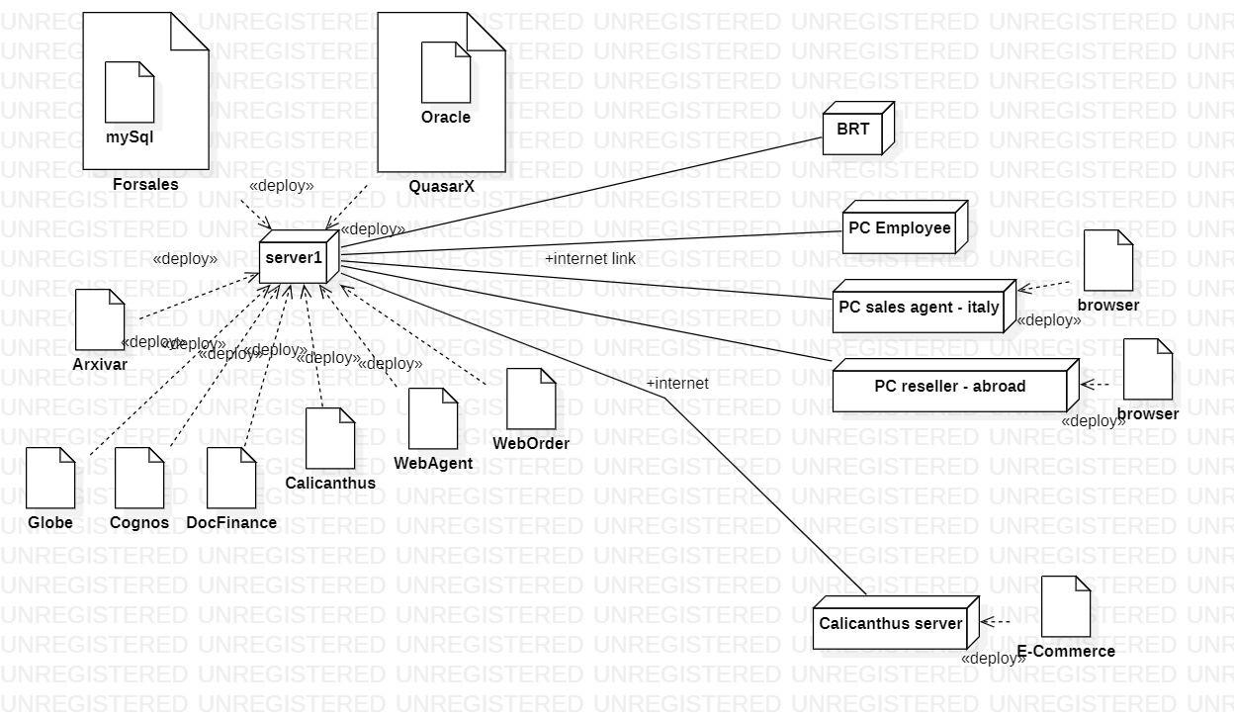
Deployment

Slide 26
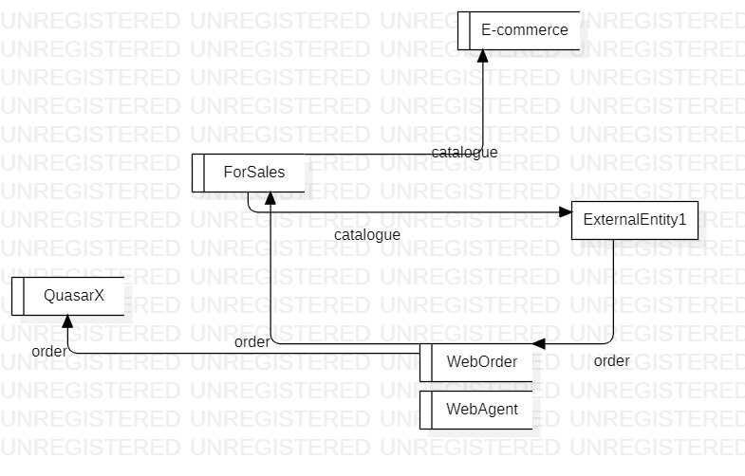
Data flow

Slide 27
Scenario - order
CMS shows catalog
webOrder receives order, enters in CMS
Sales agent can see her orders through CMS only
webOrder enters order in ERP

Slide 28
AS IS - problems
Key data (catalogue, orders) replicated in ERP + CMS + Ecommerce
B2B Order flow implies 3 tools (CMS, webOrder or webAgent, ERP)
B2C order flow implies 3 tools
Reporting: two tools/areas (sales, all rest), misalignement between reports
Reporting: no customer profiling
CRM missing

Slide 29
AS is - problems
Flow CMS – ecommerce
Requires XML flow
Not real time, issues with product availabilities

Slide 30
Path to the patchwork..
Quasar-x could not handle images
For this reason Forsales was added
Neither Quasar-x nor Forsales could do ecommerce (cart, payment, SEO, integration with marketplaces (amazon ebay), integration with aggregators (trovaprezzi, etc))
Calicanthus was added

Slide 31
Summary –As Is
Space dimension
Many tools to be integrated
Time dimension
Tools added overtime, getting to the patchwork

Slide 32
To BE – option 1
Use a CMS capable of ecommerce
Forsales + Calicanthus → newCMS
Possible tools (newCMS)
Prestashop
Storeden
..

Slide 33
To Be – option 1
Problems of duplication of information remain
Catalogue in CMS + ERP
Flow of B2B orders still apart

Slide 34
TO be – option 2
Use ERP capable of ecommerce and advanced CMS (catalogue)
Possible tools
StartyERP
One database
One flow for orders (B2C, B2B)

Slide 36
CSF
Corporate level
CSF1 Product excellence and variety (normal customer segment)
Number of items in catalogue
Quality in design
perception from customers / non customers (survey)
(specific technical measures for each product
Ex Winter jacket, capability to protect from cold , rain ..)
Quality in production
Defects or complaints from customers
Capability to collaborate with outside manufacturers to implement highly reliable quality control distantly
Capability to monitor quality of raw materials from suppliers
CSF2 Relationship with government (government customer segment)
Quality of relationship
Capability of customizing products
CSF3 Brand recognition
Mentions in the press and media
Successes and mentions of sponsored athletes / teams in press and media
survey
CSF4 capability to monitor production and warehouse to provide fastest availability and lowest inventory
Time to send item to customer (from order to delivery) (will be a KPI)
Average inventory rotation per product / per product category
CSF5 quality of relationship with END customer

Slide 37
KPI – process manage an order
Process P1: manage an order
Input: order request
(check order, check availability, ask for payment, wait for payment, close order and send acceptance to customer)
Output: order request accepted

Slide 38
General kpis
Input volume: #order requests per month
Output volume: #order requests accepted per month
Resources: employees in sales office, IS
Input volume =? Output volume
output = 0,5 input problem
output = 0,99 input, all right

Slide 39
Efficiency
UC_Order: Unit cost to process one order =
Total cost / output volume
(assuming input = output)
Time frame: one year
Total cost = cost of resources involved (in one year)
Output volume = orders accepted (in one year)
If 20 euro per hour (cost of employee) and half an hour needed per order, then unit cost is 10 euro

Slide 40
Prod_order :Productivity
orders accepted (in one year) / employee
Orders accepted (in 8 hours) employee
Orders per hour per employee
(ex 2 orders per hour)
Utilization
Time IS used / 24 hours

Slide 41
Quality
Conf_order : Conformity
#non conform orders accepted / # orders accepted – per year
Non conformity: item ordered does not exist, item is not available, order not paid, order paid partially or more, payment late
Reliability
Not meaningful
Customer satisfaction
Was it easy to place the order?
Was it easy to have support?

Slide 42
Service
LT_order : Lead time = response time (in this case)
(assuming no time in queue because web site)
Time from order request sent to order request accepted
Time in minutes
Punctuality
Not meaningful
Perfect order
Not meaningful
Flexibility
#modified order requests

Slide 43
Is this a kpi?
% orders lost because item not available
To be monitored strictly (link with warehouse management and production management)
% orders lost because no payment
Depends on customer, not controllable

Slide 44
KPI – ship an order
Process P2: ship an order
Input: shipping request
Output: order (parcel) delivered

Slide 45
Efficiency
Uc_sh = unit cost for one shipping 60 euros
Service
LT_sh = time from request to delivery < 10 days
Quality
NC_sh < 1 per million
= non conform shipping orders / total number of shipping orders
NC= wrong item(s) in box, wrong quantity , wrong address, box lost, ..

Slide 46
SLA = service level agreement
Measure used to define and monitor an outsourcing relationship
UC_sh, LT_sh, NC_sh are also SLA in the relationship between company and shipping company

Slide 47
Coverage of kpi vs CSF
P1 Process manage an order
CSF / KPi | Uc_order | Prod _order | Conf_order | LT_order
CSF1 | no | no | no | no
CSF2 | no | no | no | no
CSF3 | no | no | Very little | no | no
CSF4 | no | no | No | partially
CSF5
P2 Process ship order
CSF / KPi | UC _sh |  | Conf_sh | LT_sh
CSF1
CSF2
CSF3
CSF4 | no |  | no | Partially
CSF5
Order processing (order to delivery) = P1 + P2
CSF / KPi |  |  |  | LT_order + LT_sh
CSF1
CSF2
CSF3
CSF4 | no |  | no | yes
CSF5

Slide 48
BSC
Financial Profit per year Turnover | Customer CSF1, CSF2 Market share (also of competitors) Customer satisfaction (Returning customers)
Internal processes CSF1 (quality in production, quality in design) | Learning and innovation % spent in R & D Employee satisfaction % of time in training

Slide 50
Backup

Slide 51
Technological view

Slide 52
